Slide 1

AI Driven Research Engine for Commercial Courts
School of Computer Science and Engineering
Department of Computer Science and Engineering
Submitted By:
Shreyas Kumar Singh
2427030027
Supervised By:
Dr. Shishir Singh Chauhan

Slide 2
Outline
Introduction
Literature Review
Problem Statement
Proposed Solution
Objectives

Slide 3
Introduction
Artificial Intelligence (AI) is transforming industries, including the judicial and legal sector.
Commercial courts handle high-value and complex business disputes involving contracts, IP, and corporate issues.
Managing large volumes of legal data and research manually causes inefficiency and delays.
Traditional legal research methods are time-consuming, manual, and prone to human error.
Increasing case backlogs and growing legal data demand intelligent automation.
Judges and tribunal members need faster access to relevant case laws, precedents, and statutes.
AI can automate research, analyze judgments, and predict case outcomes with high accuracy.
The proposed system uses Machine Learning (ML) and Natural Language Processing (NLP) to enhance legal research.
It enables real-time retrieval, context-aware search, and intelligent summarization of legal documents.
Improves judicial efficiency and supports data-driven decision-making.

Slide 4
The main challenge lies in ensuring quality, relevance, and accuracy of retrieved information.
AI models such as BERT and GPT understand legal context beyond simple keyword search.
Provides contextual recommendations, trend analysis, and predictive insights.
Helps in maintaining consistency in judgments and reducing case resolution time.
Addresses judicial concerns regarding transparency, bias, and accountability in AI systems.
Designed to act as a decision-support tool, not a replacement for judicial discretion.
Incorporates ethical AI principles to ensure fairness and explainability.
Facilitates training and adoption among judges and administrators for smooth implementation.
Expected outcomes:
Reduced legal research time by 60–70%
Enhanced access to case data
Increased accuracy and uniformity in decisions
Overall, the project aims to revolutionize commercial court research through AI-powered automation and intelligent analytics.

Slide 5
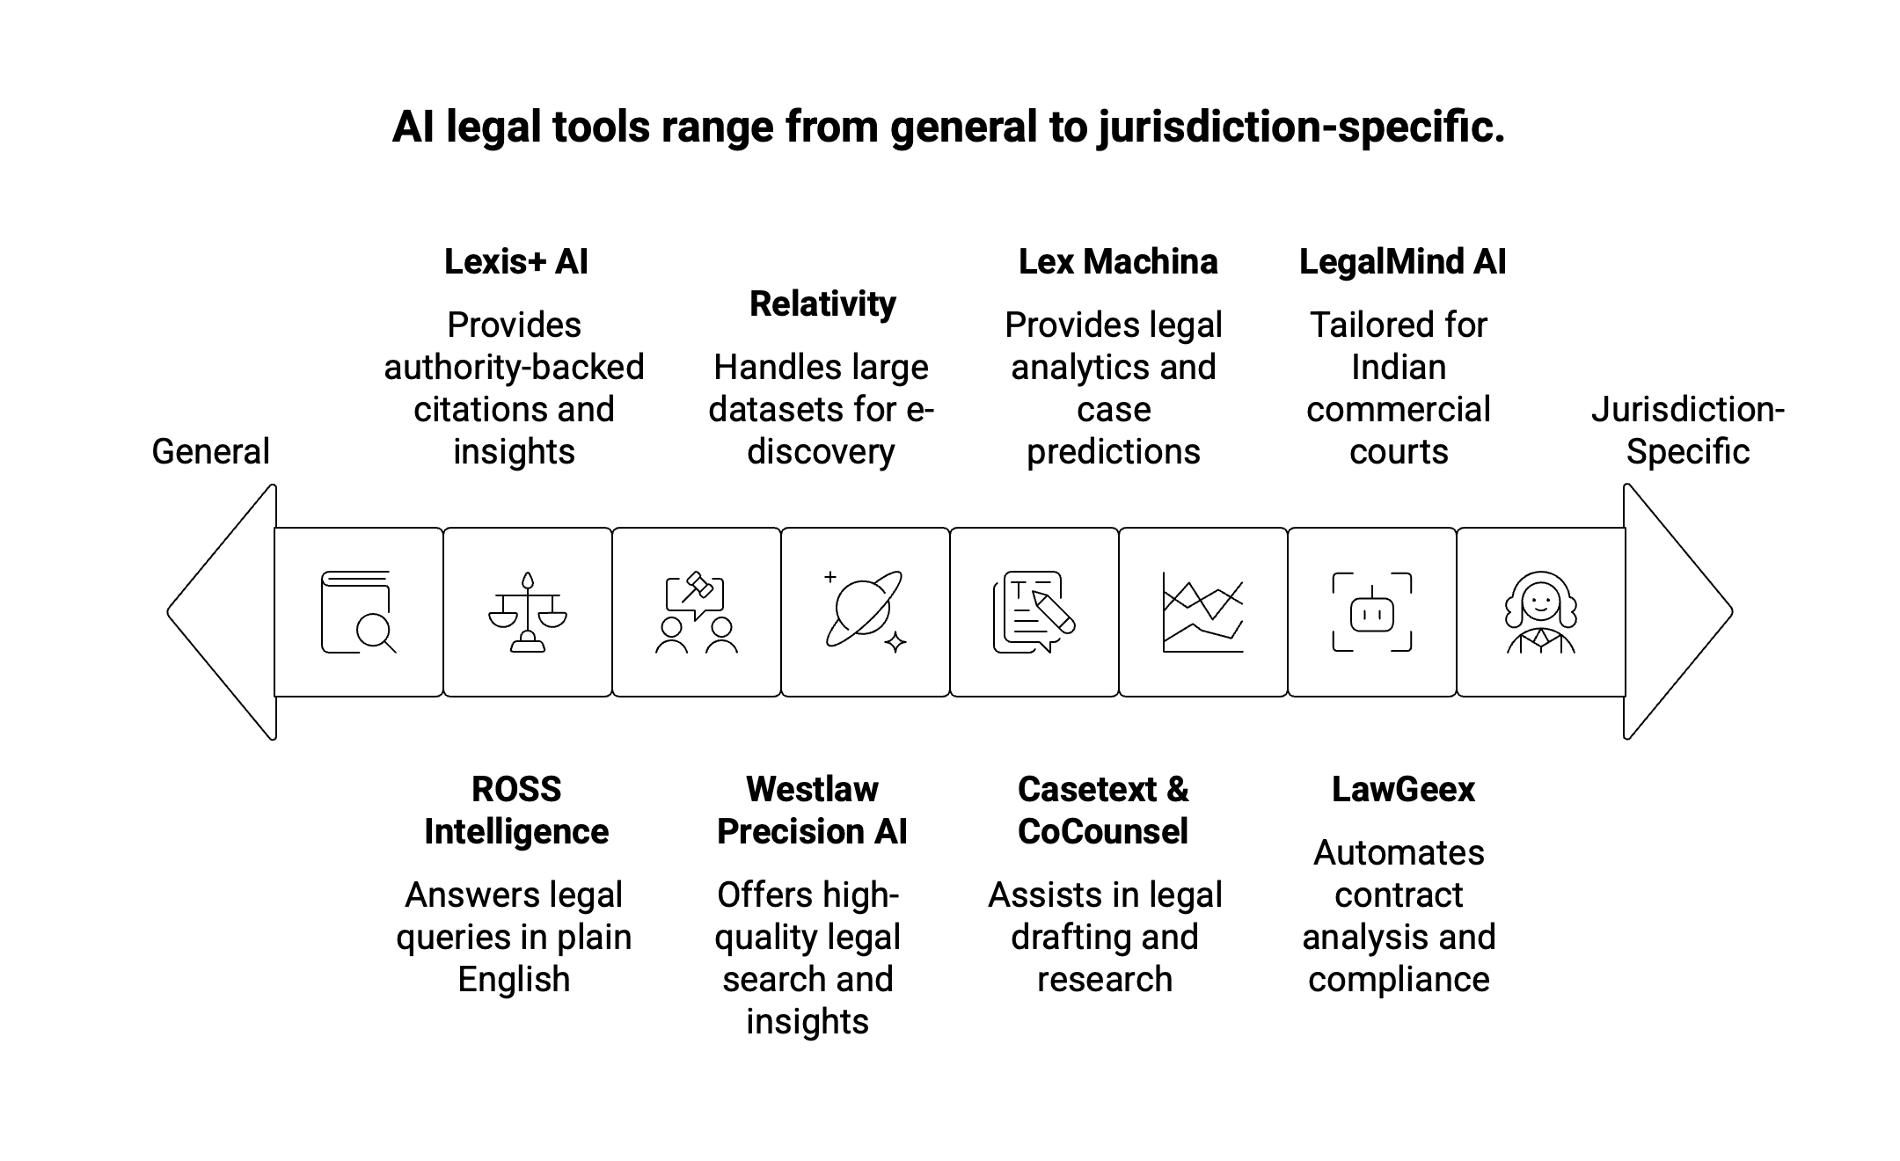
Literature Review: Existing AI Tools

Slide 6
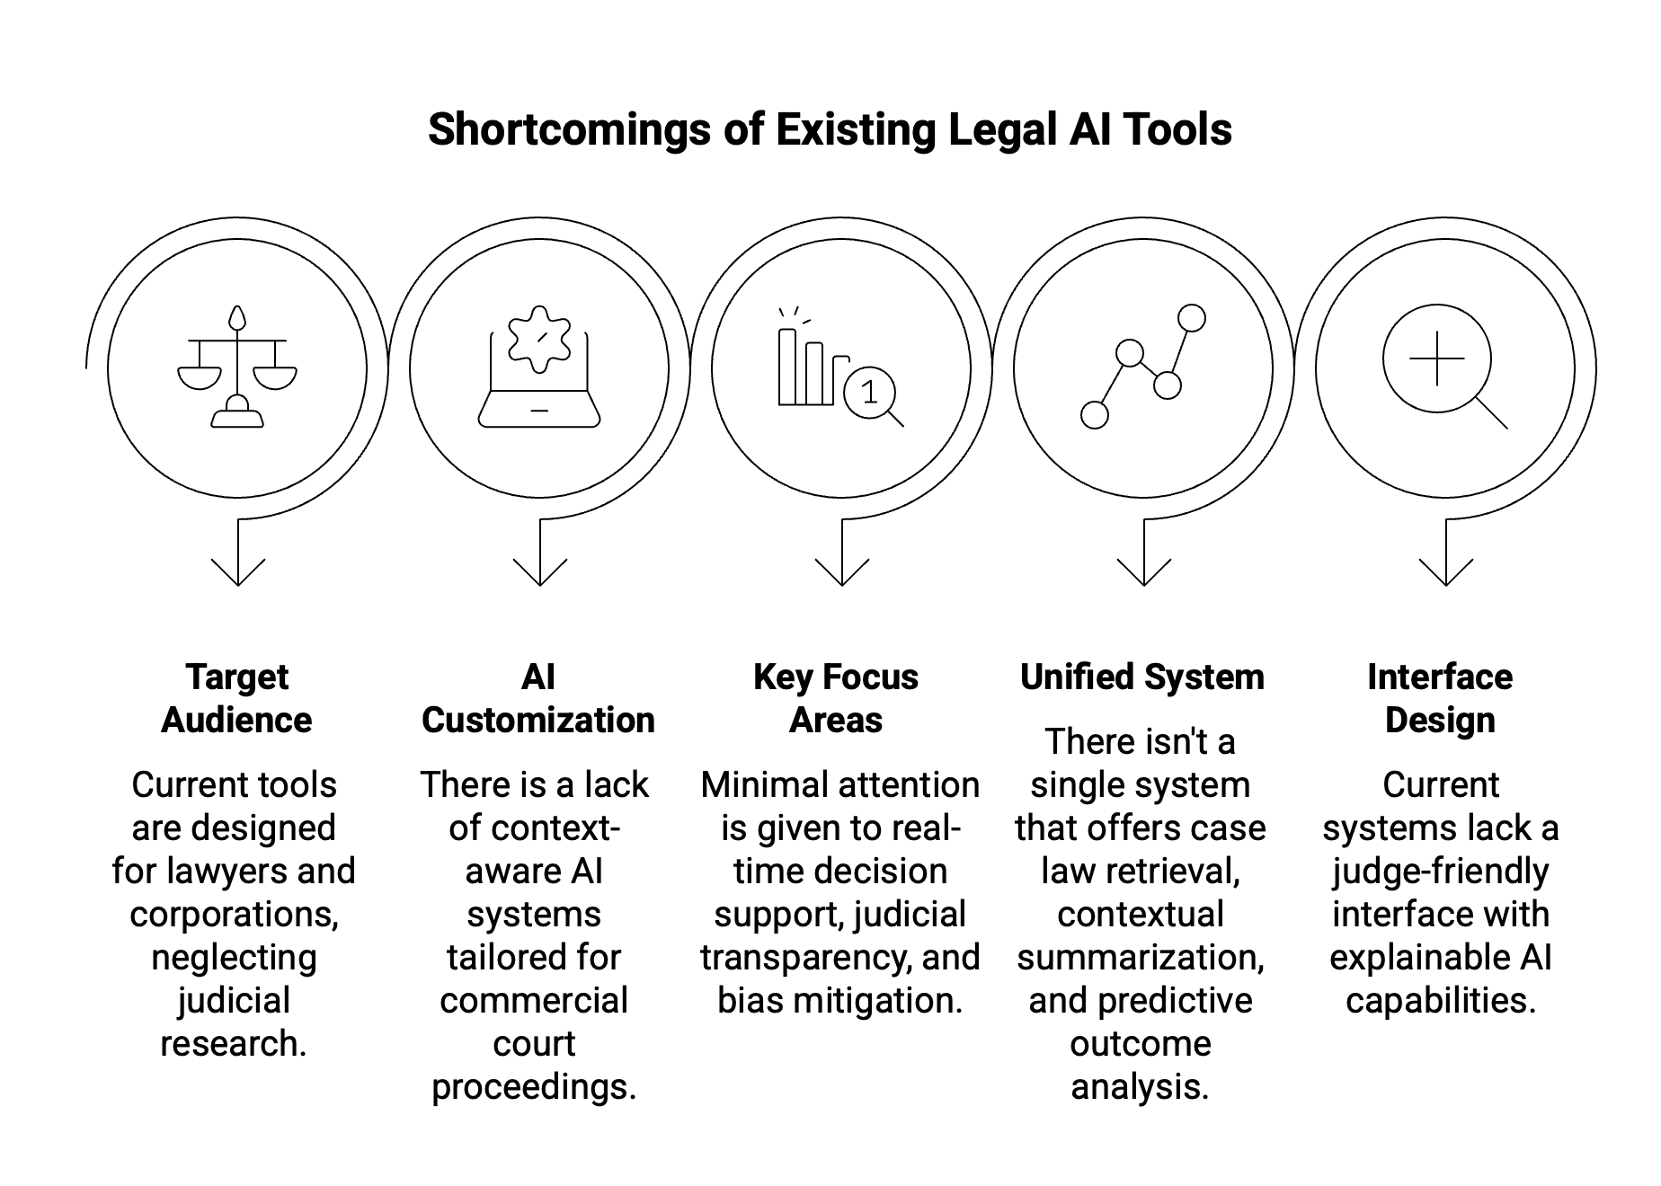
Literature Review :
Research Gaps and Need for Proposed System

Slide 7






Problem Statement
Commercial courts face inefficiencies in managing large volumes of legal data, resulting in delayed judgments and inconsistent case analysis due to the absence of an intelligent, AI-driven research system.
Visible Delays
Inconsistent Judgments
Manual Data Overload
Lack of Context‑Aware Tools
Root: No Intelligent Legal Research

Slide 8
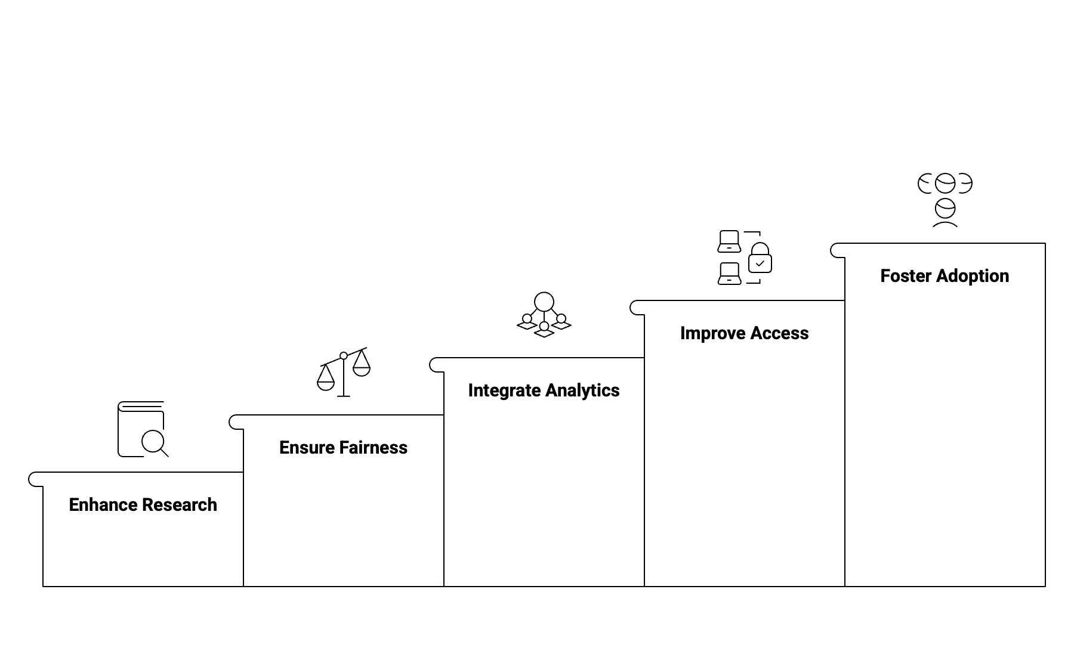
Objectives

Slide 9
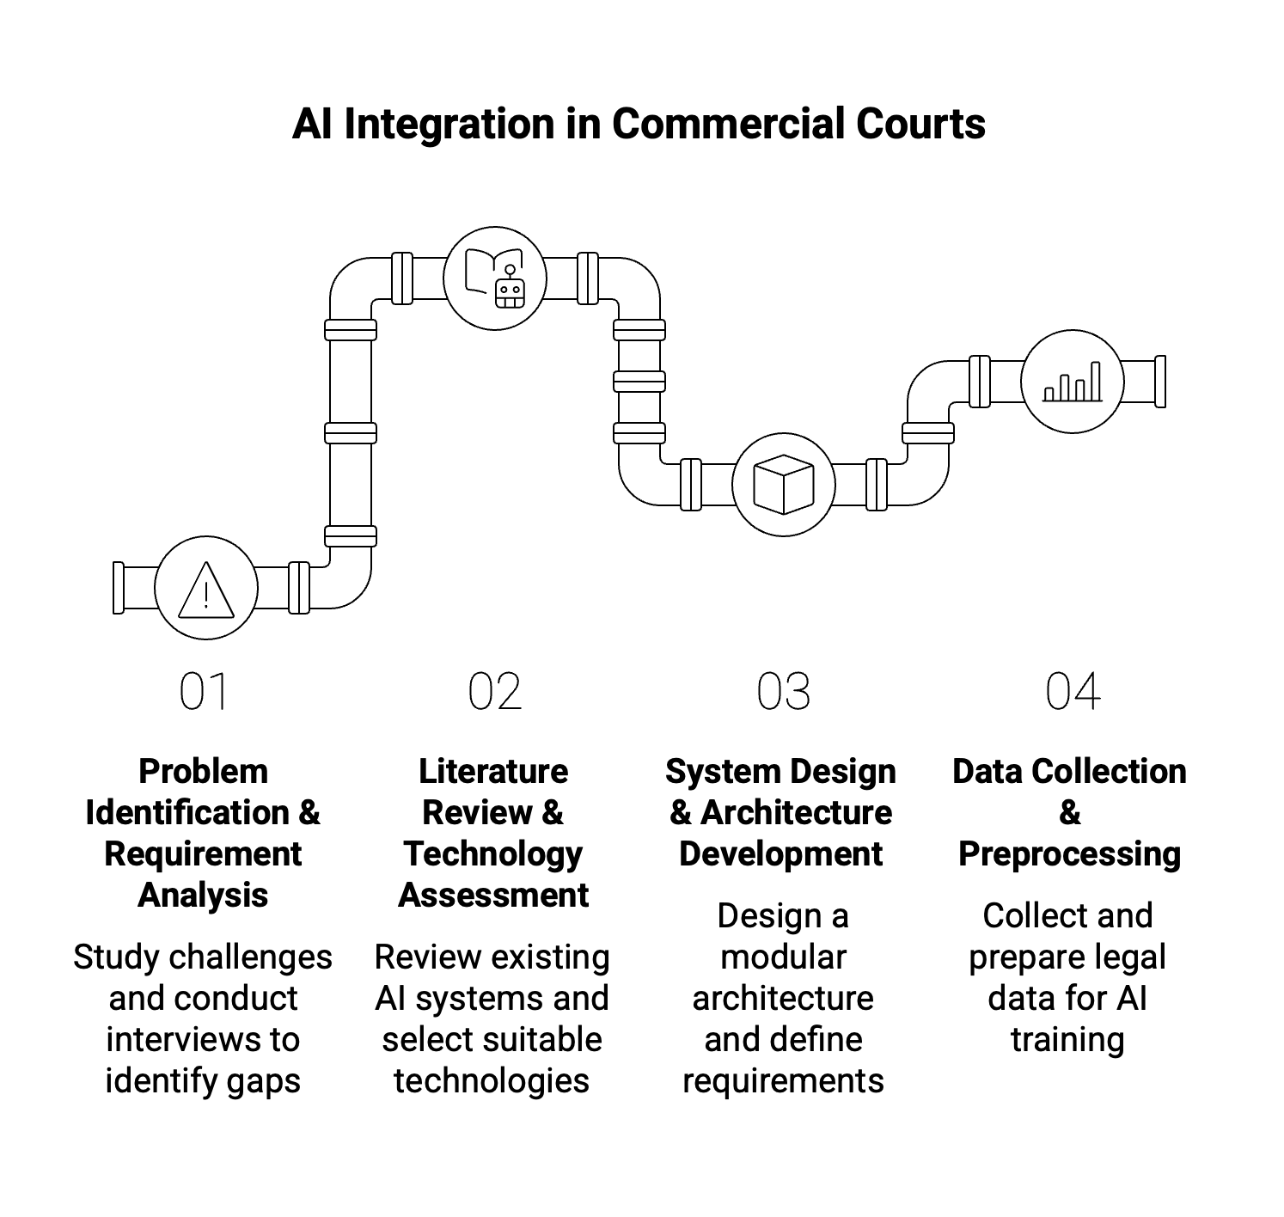
Proposed Methodology : Initial Steps

Slide 10
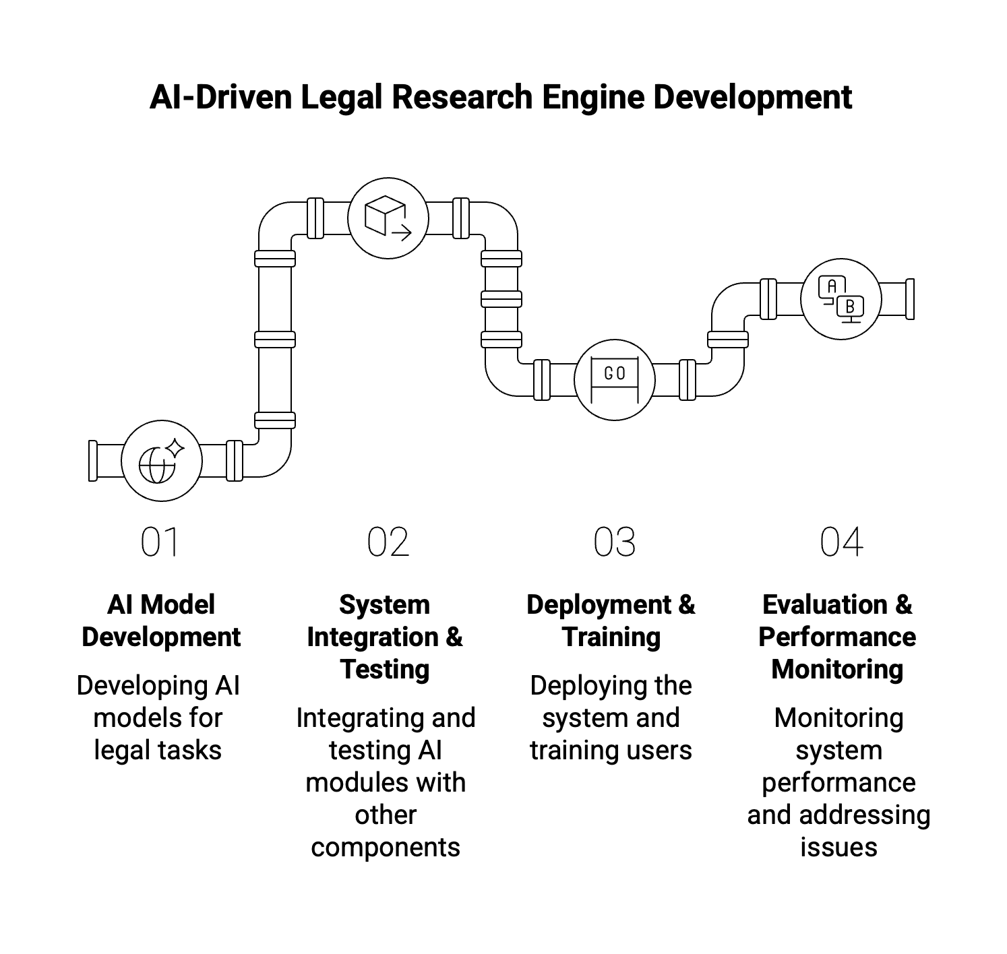
Proposed Methodology:
Advanced Implementation

Slide 11
Result
<in tabular, graphical, figures>
<to be updated later>

Slide 12
References
<One slide>

Slide 13
Thank You

